Slide 1

Programming Fundamental
Week 15
Sobia Iftikhar
Sobia.Iftikhar@nu.edu.pk

Slide 2
We’ll Learn Today
1 - Double pointers (basics) 2 - Type casting in pointers (basics) 3 - Pointer to const value 4 - Const pointer to const value 5 - Const pointer to value

Slide 3
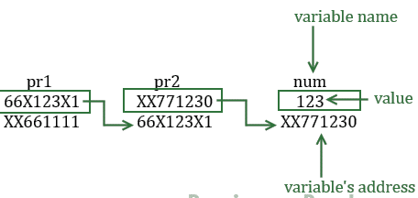
Double Pointer
We already know that a pointer holds the address of another variable of same type. When a pointer holds the address of another pointer then such type of pointer is known as pointer-to-pointer or double pointer.
How to declare a Pointer to Pointer (Double Pointer) in C?
int **pr;

Slide 4
Example
/* Possible ways to find value of variable num*/
printf("\n Value of num is: %d", num);
printf("\n Value of num using pr2 is: %d", *pr2);
printf("\n Value of num using pr1 is: %d", **pr1);
/*Possible ways to find address of num*/
printf("\n Address of num is: %p", &num);
printf("\n Address of num using pr2 is: %p", pr2);
printf("\n Address of num using pr1 is: %p", *pr1);
/*Find value of pointer*/
printf("\n Value of Pointer pr2 is: %p", pr2);
printf("\n Value of Pointer pr2 using pr1 is: %p", *pr1);
/*Ways to find address of pointer*/
printf("\n Address of Pointer pr2 is:%p",&pr2);
printf("\n Address of Pointer pr2 using pr1 is:%p",pr1);
/*Double pointer value and address*/
printf("\n Value of Pointer pr1 is:%p",pr1);
printf("\n Address of Pointer pr1 is:%p",&pr1);
return 0;
}
#include <stdio.h>
int main()
{
int num=123;
//A normal pointer pr2
int *pr2;
//This pointer pr2 is a double pointer
int **pr1;
/* Assigning the address of variable num to the
* pointer pr2
*/
pr2 = &num;
/* Assigning the address of pointer pr2 to the
* pointer-to-pointer pr1
*/
pr1 = &pr2;

Slide 5
Output
Value of num is: 123
Value of num using pr2 is: 123
Value of num using pr1 is: 123
Address of num is: XX771230
Address of num using pr2 is: XX771230
Address of num using pr1 is: XX771230
Value of Pointer pr2 is: XX771230
Value of Pointer pr2 using pr1 is: XX771230
Address of Pointer pr2 is: 66X123X1
Address of Pointer pr2 using pr1 is: 66X123X1
Value of Pointer pr1 is: 66X123X1
Address of Pointer pr1 is: XX661111

Slide 6
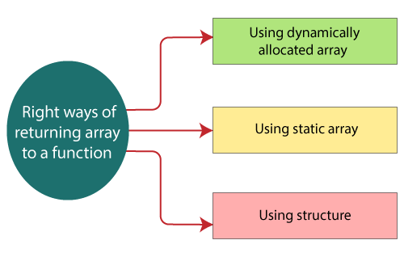
Return array from function
There are three right ways of returning an array to a function:
Using dynamically allocated array
Using static array
Using structure

Slide 7
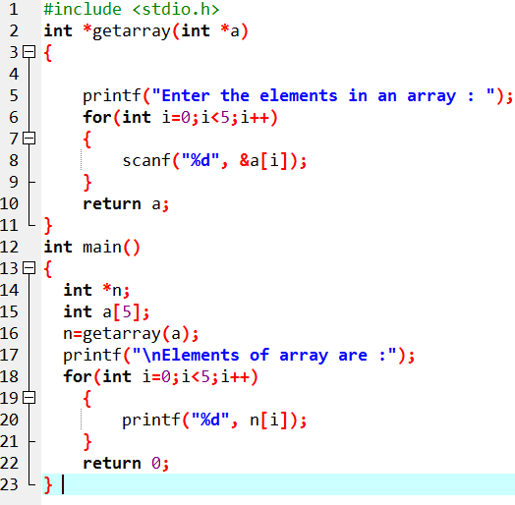
Returning array by passing an array which is to be returned as a parameter to the function.

Slide 8
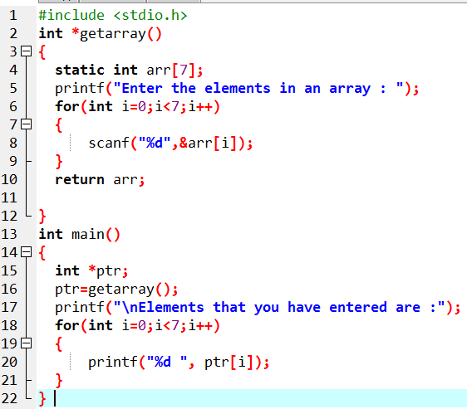
Using Static Variable

Slide 9
Casting Pointers
When assigning a memory address of a variable of one type to a pointer that points to another type it is best to use the cast operator to indicate the cast is intentional (this will remove the warning)
Example:
int V = 101;
float *P = (float *) &V; /* Casts int address to float * */
Removes warning, but is still a somewhat unsafe thing to do

Slide 10
The General (void) Pointer
A void * is considered to be a general pointer
No cast is needed to assign an address to a void * or from a void * to another pointer type
Example:
int V = 101;
void *G = &V; /* No warning */
float *P = G; /* No warning, still not safe */
Certain library functions return void * results (more later)

Slide 11
Pointer to const value

Slide 12
Thankyou

